Slide 1

Question Bank – Problem Sets
Approach and Discussions
Notes:
1

Slide 2
Table of Contents
Question Bank - Overview / Definition
Purpose
Task List at hand
Delivery / Authoring Process
Criteria of Variation – Data / Difficulty Level / Use Case Variation?
Envisage Workflow and UI details
Impact on App / Paint / Player
Implementation Details
Workflow / Presentation Details
Launch / Navigation to Problem sets
Presentation Approach
UI / UX
Implementation Approach
How to relate / group variations
Impact on App/Leonardo/ Paint
Displaying Reports
Related Enhancements
Learning Aids
Search criteria - Learning Aids, Keywords
Notes:
2

Slide 3
Overview / Definition

Slide 4
What is Question Bank & Problem Sets
A Question Repository containing multiple type of Questions
MCQ
Ques 1
Ques 2
Ques 3 …
Leonardo
Ques 1
Ques 2
Ques 3 …
Cosmatt Widgets
Ques 1
Ques 2
Ques 3 …
Includes Variations of Questions – Problem Sets
Leonardo
Ques 1
Variation 1
Variation 2
Variation 3
Ques 2

Slide 5
What is the Objective?
Extensive number of Questions for Practice / HW / Assessment
Provides access to 10 – 20 Variations of the same problem for practice and assessment purposes
Avoiding Plagiarism / Cheating
A Different variant of each problem can be presented to the student to avoid cheating.
Provision of adjusting the Difficulty Levels
Novice, Medium and Advanced Users
Adaption to specific syllabus / Books
Categorization on the basis of different books or syllabus (learning Objects)
Capability to add questions to assignments created in COSMATT or some other LMS like CANVAS.

Slide 6
Initial Considerations – Problem Sets
Task List
Content Authoring and Management Process
Sanjeev Syal and Team | Variations of only Leonardo Questions or other also? – (Leonardo to start with) Select problems to variate – (Comprehensive) Introduce difficulty levels – Yes / No / Later - (Later) Only data variations or Scenario/Use Case variations (Scenario)
Envisage Workflow and UI details
Application | Instructor Workflow Create Assignment from Question Bank Enable Variations for different Students / same student Maintaining “My list” Student Workflow Take Assignments setup by Instructor How problem varies (retry?, login?)
Presentation Approach
Application | UI / Presentation Approach of the Question repository Categorization – Difficulty level, LO, Book?
Implementation Approach
Application, Leonardo, Paint? | How to relate / group variations Impact on App/Leonardo/ Paint Displaying Reports
Related Enhancements
TBD | Learning Aids Search criteria - Learning Aids, Keywords

Slide 7
Envisage Workflow and UI details
Instructor Workflow
Student Workflow

Slide 8
Instructor Workflow
Create Assignment from Question Bank
Enable Variations for different Students / same student
Maintaining “My list”

Slide 9
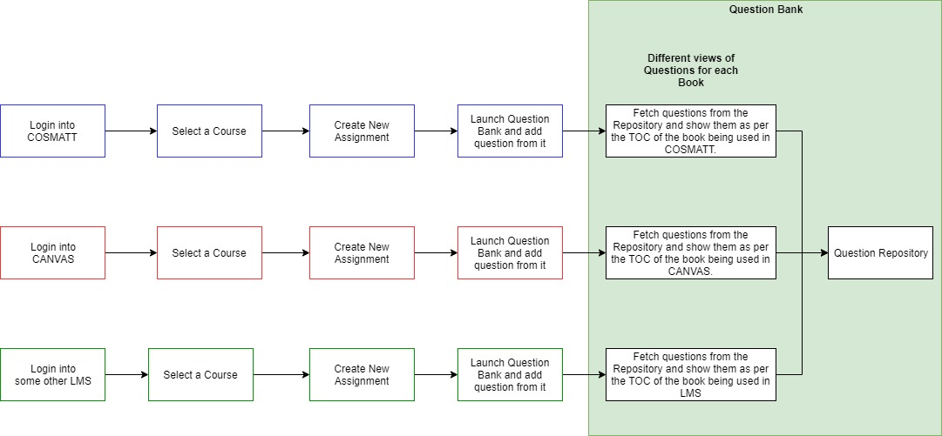
Instructor Workflow
Refer below diagram for the Instructor’s workflow of adding questions from the Question Bank:

Slide 10
Question Bank - Categorization Approach
Question Type
LO
Book
Difficulty Level

Slide 11
Question Bank - Categorization Approach
xxxx

Slide 12
Student Workflow
Take Assignments setup by Instructor
How problem varies (retry?, login?)

Slide 13
Student Workflow
Refer below PPT for the Student’s workflow:

Slide 14
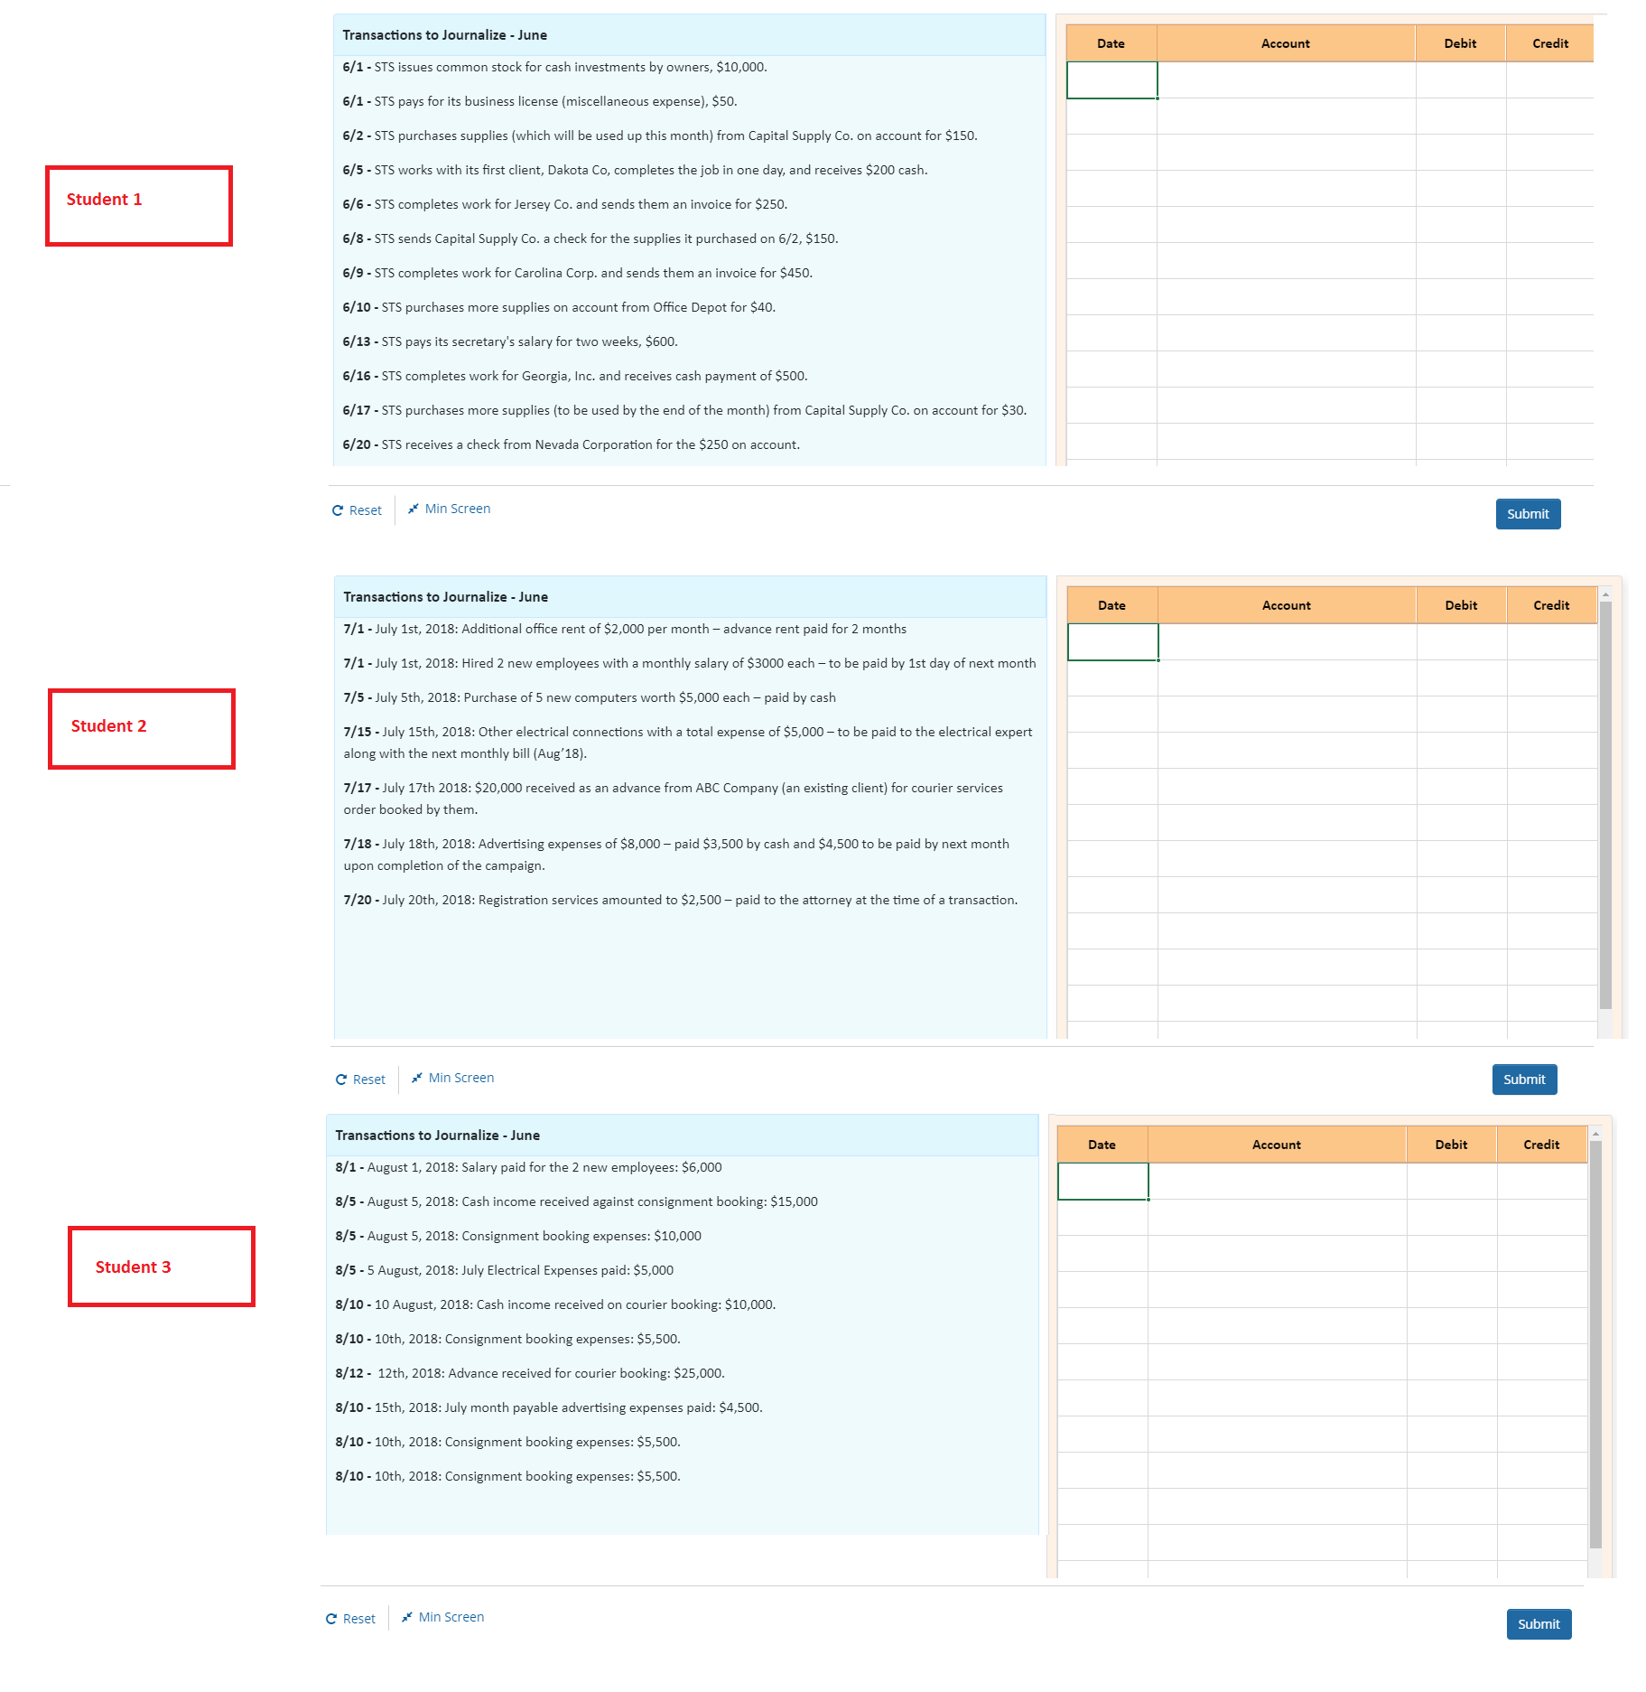
Variations

Slide 15
Implementation Approach
How to relate / group variations
Impact on App/Leonardo/ Paint
Displaying Reports

Slide 16
How to relate / group variations?
How do Variations of Problem Sets be categorized
Item children
Var 1
Var 2
Items related via some ID or Tag
Item 1 -> IDXX
Item 2 -> IDXX
Item 3 - > IDXX
???

Slide 17
Impact on App/Leonardo/ Paint
App
Rendering
Player
Leonardo
Grading with Scores and reports
Paint
Adding related variations to an Item

Slide 18
Grades and Reports
If this is not a part of Content, will “My Progress” be available here?

Slide 19
End Of Presentation
Notes:
19

Slide 20
Queries

Slide 21
Queries
The Approach forward variates as per the answers to following Questions
Is Variation an Assessment feature Only? Or needed in “Test your Understanding also?
In Assessment, it doesn’t add value to have multiple variations of the same skill.
But the feature of assigning different instances of the similar questions to different students adds value to avoid plagiarism
Even varying Data only can also serve the purpose and this approach can be later matured to have Algorithmic Variations.
In this case, assuming the all Questions will be available to the instructor but student gets access only if instructor assigns a question(s) to him
If “Problem Sets” is needed as a part of “Test Your understanding”, then multiple similar skill using Questions can be added for Practice
Here just varying the data doesn’t make sense but varying the nature and number transactions can help understand better.
All Questions can be available to him Or feature to show on the fly out of the available set is required.

Slide 22
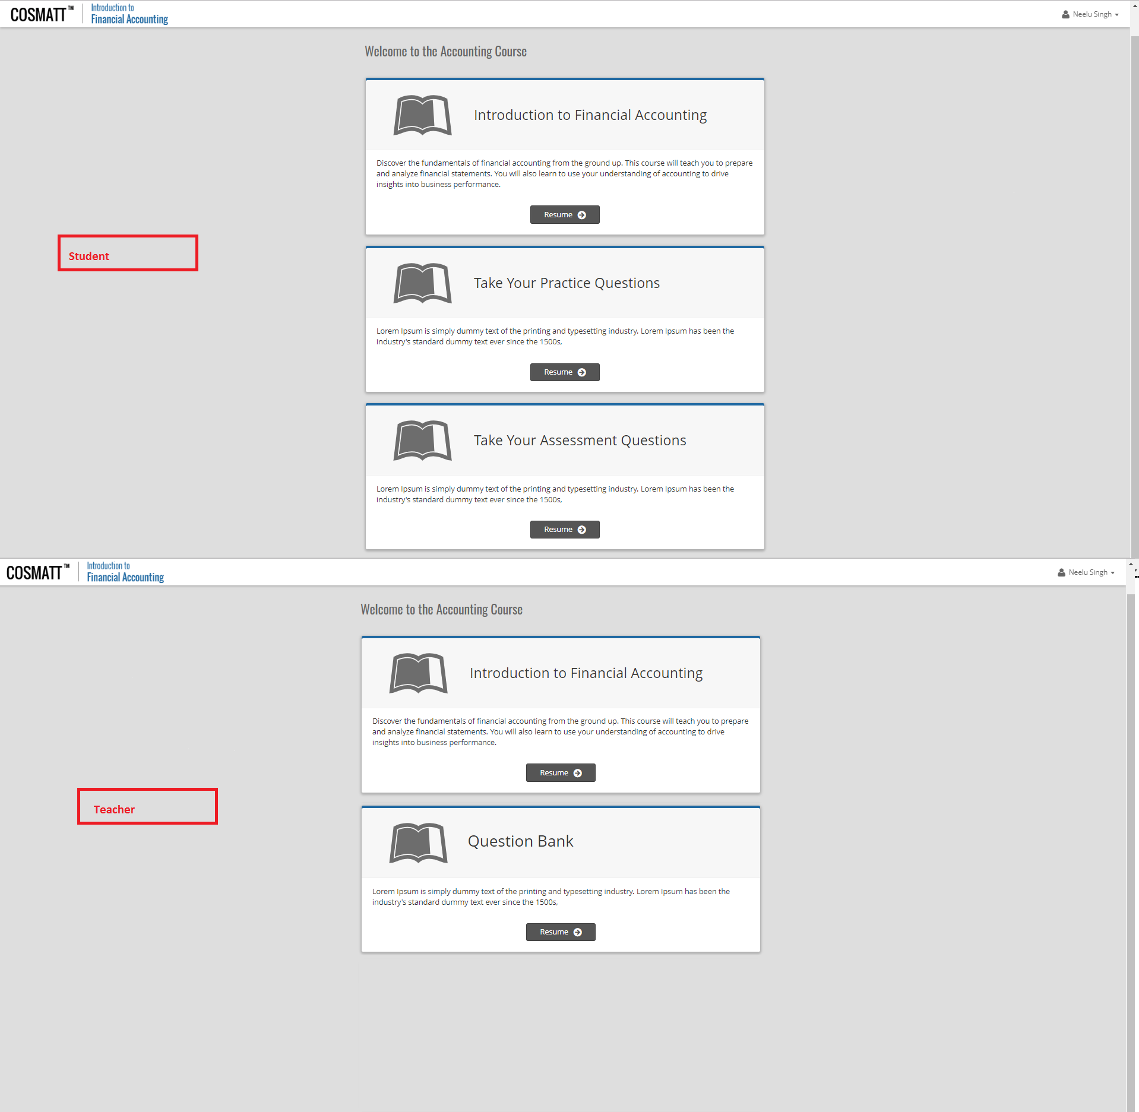
Option 1: Course Page
Add two placeholders / courses for Practice / Assessment?

Slide 23
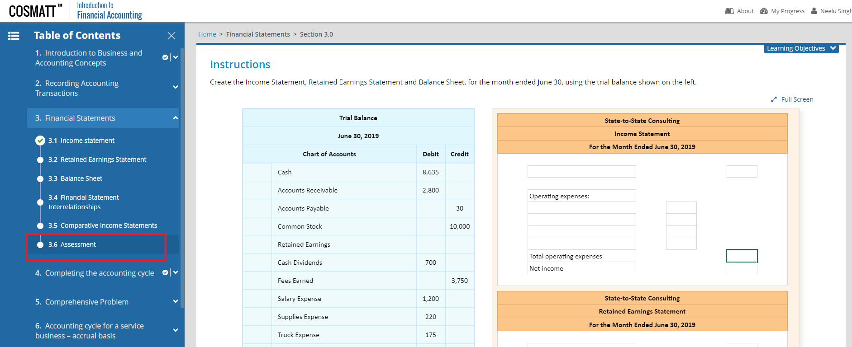
Option 2: Inline with Content
Option 2a – Along each Chapter
Option 2b – End of Course Assessment

Slide 24
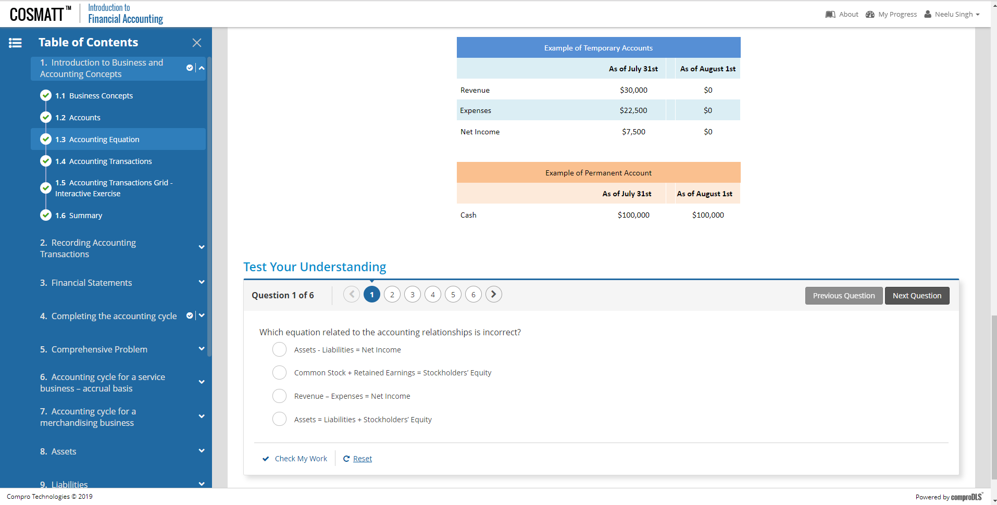
Option 2: As Test Your Understanding Question Type

Slide 25
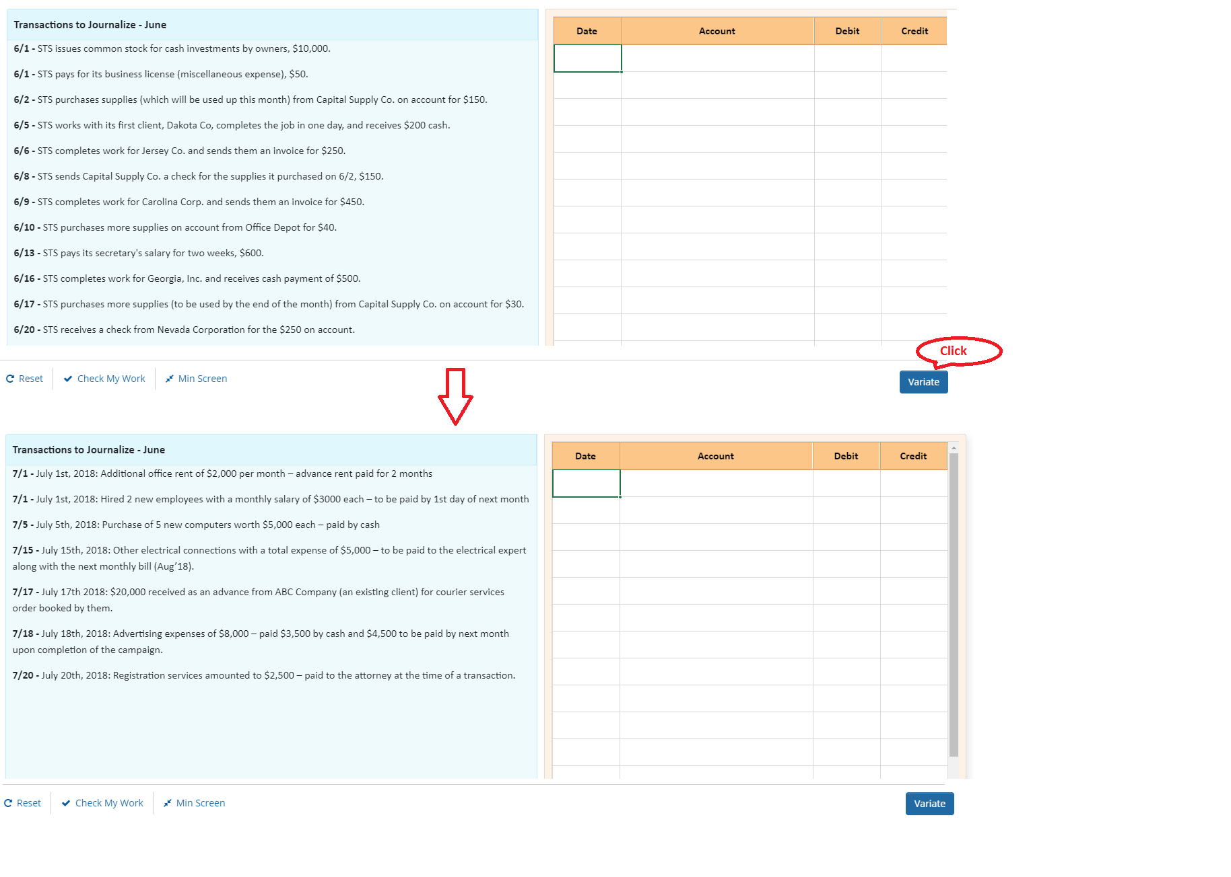
Test Your Understanding Mode – Option 1 (New Button)

